Slide 1

Depth First Search

Slide 2
DEPTH FIRST SEARCH
It traverses graph ‘Depth-first’ starting from source , then picks one of the unvisited neighbours and visit it.
It is an recursive algorithm for the traversal of graph.
Recursion goes deeper into branch until it cant go further.
Multiple ordering are possible.
For DFS we require two thing:-
Recursive Call on the univisted node.
Array and map to know which node is visited or not

Slide 3
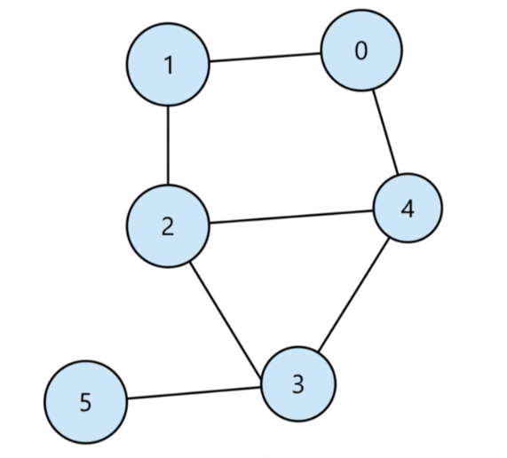
Depth First Search(DFS)

Slide 4
Let say I started from Vertex 0 and mark it visited. And I will pick one vertex which isn’t visited. So I can go to either 1 or 4.Then I visit 1.After visiting 1 I go to 2 then to 4 . After 4 I will go to 3. At last I reach 5. From 5 I cant go anywhere so I return back. I return to 3 but from 3 even I cant go anywhere . So I return back. And doing this I return to main. And due to this multiple order can be possible because we can push any of the neighbour vertex which aren’t visited .
1
0
2
4
3
5

Slide 5
Recursive Call on NODE
0
Visited
0
1
0
2
4
3
5

Slide 6
Recursive Call on NODE
1
0
Visited
1
0
1
0
2
4
3
5

Slide 7
Recursive Call on NODE
2
1
0
Visited
2
1
0
1
0
2
4
3
5

Slide 8
Recursive Call on NODE
4
2
1
0
Visited
4
2
1
0
1
0
2
4
3
5

Slide 9
Recursive Call on NODE
3
4
2
1
0
Visited
3
4
2
1
0
1
0
2
4
3
5

Slide 10
Recursive Call on NODE
5
3
4
2
1
0
Visited
5
3
4
2
1
0
1
0
2
4
3
5
There are no unvisited node left so recursion terminates.
Output :- 0 1 2 4 3 5
As said earlier there can be multiple output , depends upon the node you push.

Slide 11
void dfs (T src){ //This map is used to keep a track of visited vertices map<T , bool>visited; //The main recursive function of dfs dfsHelper (src , visited); } void dfsHelper (T node , map<T , bool>&visited){ //Whenever you come to a node mark is visited visited[node] = true; //Print the node you visit cout<<node<<" "; //Try to find out if neighbour is visited or not //If not visited then visit it. for(T neighbour : adjList[node]){ if(!visited[neighbour]){ dfsHelper( neighbour , visited); } } }

Slide 12
Time Complexity
Linear in terms of vertex and edges o(V+E) using adjacency list. O(V^2) using adjacency matrix.
Space Complexity
O(V). Because the call stack at max is made of size of no of vertices.
Application
Traversing the graph recursively
Finding the connected components
Easy to implement but cant find shortest path
Used in Flood-Fill Algorithm
Used in cycle detection and topological sorting

